Slide 1
Git Workflow

Slide 2
Version Control
What is “version control”, and why should you care? Version control is a system that records changes to a file or set of files over time so that you can recall specific versions later.
If you are a graphic or web designer and want to keep every version of an image or layout (which you would most certainly want to), a Version Control System (VCS) is a very wise thing to use. It allows you to revert selected files back to a previous state, revert the entire project back to a previous state, compare changes over time, see who last modified something that might be causing a problem, who introduced an issue and when, and more. Using a VCS also generally means that if you screw things up or lose files, you can easily recover.

Slide 3

Local Version Control Systems
Many people’s version-control method of choice is to copy files into another directory. This approach is very common because it is so simple, but it is also incredibly error prone. It is easy to forget which directory you’re in and accidentally write to the wrong file or copy over files you don’t mean to.
To deal with this issue, programmers long ago developed local VCSs that had a simple database that kept all the changes to files under revision control.

Slide 4
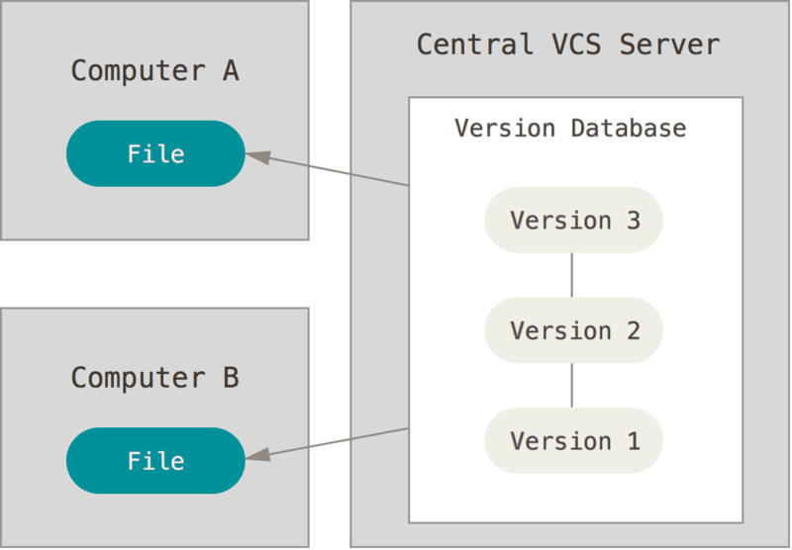
Centralized Version Control Systems
The next major issue that people encounter is that they need to collaborate with developers on other systems. To deal with this problem, Centralized Version Control Systems (CVCSs) were developed. These systems (such as CVS, Subversion, and Perforce) have a single server that contains all the versioned files, and a number of clients that check out files from that central place. For many years, this has been the standard for version control.

Slide 5
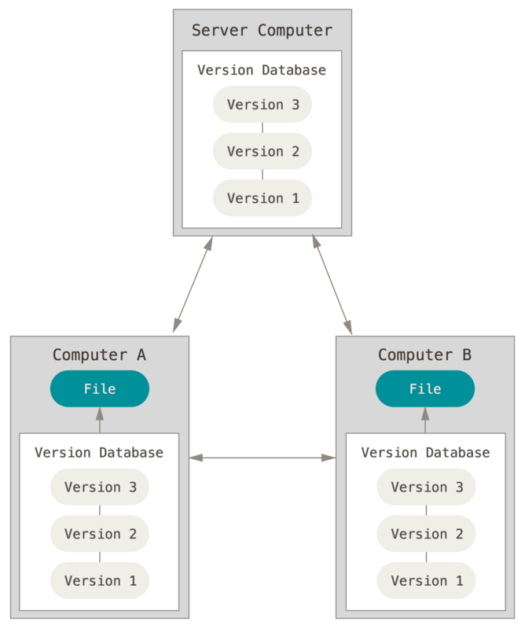
Distributed Version Control Systems
This is where Distributed Version Control Systems (DVCSs) step in. In a DVCS (such as Git, Mercurial, Bazaar or Darcs), clients don’t just check out the latest snapshot of the files; rather, they fully mirror the repository, including its full history. Thus, if any server dies, and these systems were collaborating via that server, any of the client repositories can be copied back up to the server to restore it. Every clone is really a full backup of all the data.

Slide 6
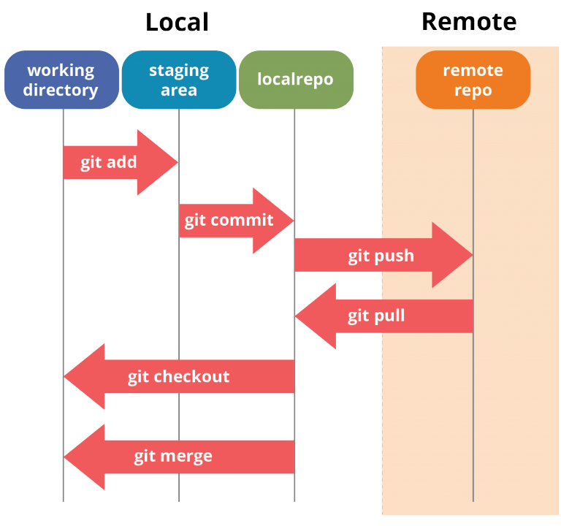
Git Architecture

Slide 7
Git Architecture
Working directory: This is created when a Git project is initialized onto your local machine and allows you to edit the source code copied.
Staging area: Post the edits, the code is staged in the staging area by applying the command, git add. This displays a preview for the next stage. In case further modifications are made in the working directory, the snapshots for these two layers will be different. However, these can be synced by using the same ‘git add’ command.
Local repository: If no further edits are required to be done, then you can go ahead and apply the git commit command. This replicates the latest snapshots in all three stages, making them in sync with each other.

Slide 8
Role of Git in DevOps
Git plays a vital role in DevOps. DevOps is responsible for the development and operation processes of software. It allows non-linear workflows in a distributed manner by providing data assurance to create quality software. This tool offers a space for developers to work. All the users are notified when any of the developers make changes in the file.
Git allows developers to collaborate and makes it easy for them to visualize the work, saving a lot of time and effort. Further, Git helps in code management that can be pushed to the shared repository, making the code ready to be integrated, tested, and deployed. It eases the communications between the development department and the operations department, making it the best suitable tool in DevOps.

Slide 9
Git Commands
git init: This Git command converts a directory into an empty repository. This is the initial step you need to take to build a repository. Once you run git init, you will be able to add and commit files and directories.
git add: This command allows you to add files in the Git staging area. The file must be added to the index of Git before being available to commit to any particular repository. You can use this command to add directories, files, etc.
git commit: The commit command in Git allows you to track the changes in the files in a local repository. Each commit has its own unique ID for reference.
git status: The git status command returns the present state of a repository, like if the file is in the staging area but has not been committed.
git config: There are numerous configurations and settings possible in Git, and this command allows you to assign these settings. User.name and user.email are the two significant settings that set the name and email address of a user.
git branch: This command determines the branch of the local repository and allows you to add or delete a branch.
git checkout: You can use this command to switch to another branch.
git merge: The merge command allows you to integrate two or more branches together. It combines the changes made in the branches.

Slide 10
Git Commands
git remote: This Git command allows you to connect a remote repository to a local repository.
git clone: You can use the clone command to create a local copy of an already existing remote repository. This allows you to copy and download the required repository to the system. It is similar to the init command while working with remote repositories as it allows you to build a local directory, consisting of all the necessary files and history of the repository.
git pull: The pull command is used to run the latest version of any repository. This pulls all the changes made from the remote to the local repository.
git push: This command sends local commits to the respective remote repository. It needs two parameters, i.e., the remote repository and the specific branch where it needs to be pushed.

